Slide 1
Slime AI
Software Studio 軟體設計與實驗
Hung-Kuo Chu
Department of Computer Science
National Tsing Hua University
CS2410

Slide 2
Important
We use Cocos Creator 2.4.8 in this course.
Please make sure you use the same version, otherwise your program may crash when we test it.
Remember to go to scripts/firebase.js to add your Firebase config for deployment!
See Appendix-Cocos Creator & Firebase to review how to build and deploy.

Slide 3
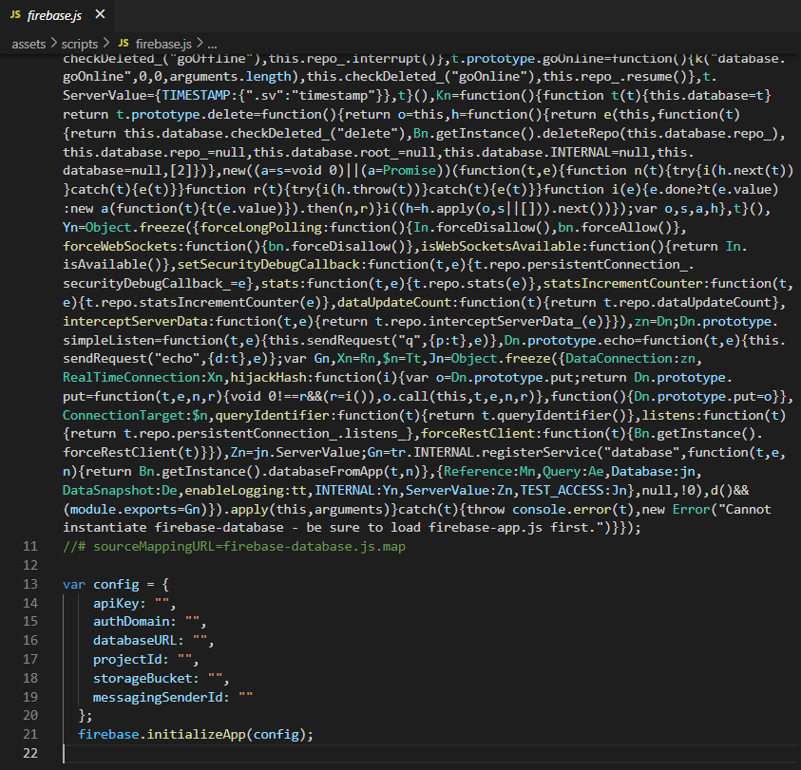
Add your config here!

Slide 4
Goal
Fork repo Lab8-Slime AI to your repository.
Open scene level1-1.
Open the project in your code editor and search for TODOs, then complete the requirements.
For this lab, you will only need to modify scripts under the “scripts/ai” folder!

Slide 5
Goal (Cont’d)
You can see TA’s demo here: https://ab-4a13f.web.app/

Slide 6
Controls
Use arrow keys to move the main character.

Slide 7
TODO 1
Files: Wanderer.ts (1.1, 1.2, 1.3), WanderAgent.ts (1.4)
Follow the hints in these files to implement blue slime’s behavior.
End result: The blue slime should alternate between moving in a random direction and stopping.

Slide 8
TODO 2
File: ShyAgent.ts (2.1, 2.2)
Follow the hints in the file to implement green slime’s behavior.
End result: The green slime should run away from the player when they get too close and go back to wandering once far away enough from the player.

Slide 9
TODO 3
Files: Navigator.ts (3.1), NavWanderer.ts (3.2), NavWanderAgent.ts (3.3)
Follow the hints in the files to implement yellow slime’s behavior.
End result: The yellow slime should be changing directions on the four waypoints of Waypoint Graph 1.

Slide 10
TODO 4
Files: WaypointGraph.ts (4.1), NavChaser.ts (4.2)
Follow the hints in the files to implement red slime’s behavior.
End result: The red slime should be able to track down the player when the player is in the right side of the map.

Slide 11
TODO 5
File: TODO5.ts (5)
Turn the slimes in the scene into prefabs (you can put them under the Prefab folder) and instantiate them in the scene according to TODO5.ts’s instructions.

Slide 12
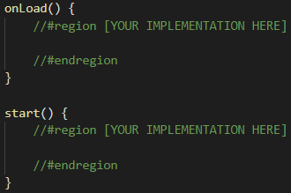
Some important concepts
onLoad(): Called when the node the component is attached to is loaded.
start(): Called after onLoad().

Slide 13

Some important concepts
update(dt: number): Called every frame in the game. dt is time passed since last frame.

Slide 14
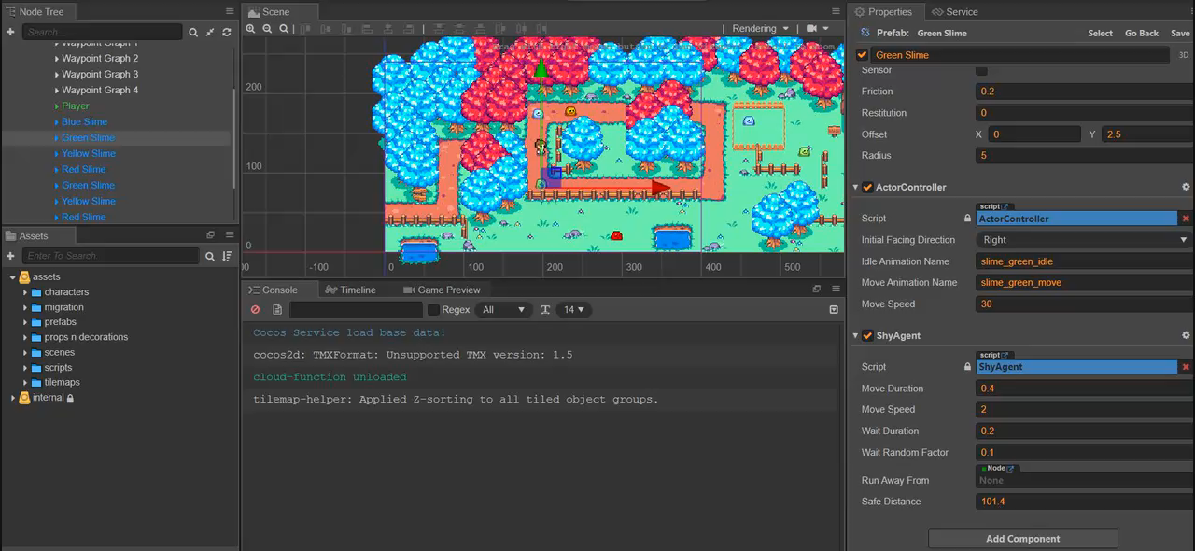
Some important concepts
You can drag a node that has a certain component into the inspector to assign a reference to that component.

Slide 15
Hints
You can complete every item without checking the Cocos Creator API.
Use the methods we have prepared for you!
You’ll mainly need knowledge on TypeScript OOP.
Review past lecture slides or search online if you aren’t sure about the syntax!
Read the comments to understand what each class property and method is for!

Slide 16
Deadline
Deadline: 2022/04/19 17:20
Deploy your game to Firebase and give us the link!
Remember to build your game!
Remember to compress and submit your project’s files excluding “node_modules” to the FTP as well.

Slide 17
Grading Policy
You will get 0 point if your program crashes during the test. (Ex: code hang)
Content | Score
Blue slime uses the Wanderer strategy properly. | 30%
Green slime uses the Wanderer and Coward strategies properly. | 30%
Yellow slime uses the NavWanderer strategy properly. | 20%
Red slime uses the NavChaser strategy properly. | 10%
All slimes are turned to prefabs and instantiated in the scene according to TODO5.ts.* | 10%

Slide 18
Grading Policy (Cont’d)
*For the last item, we will give you all marks if all slimes that you have actually implemented are acting properly.
Ex: If you failed to implement red slime, we will only verify blue, green, yellow slimes’ prefabs.
You will not get any marks here if no slime is functioning properly at all.

Slide 19





